Slide 1



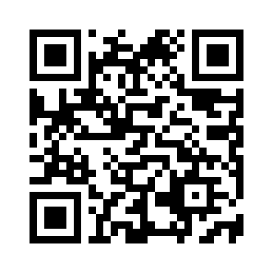
DHANUSH H V Projects
PyQR-HVD
Enter URL/data to Encode
Preview - QR-Code
Generate
Refresh

Slide 2
DHANUSH H V Projects
PyQR-HVD
Enter URL/data to Encode
Input space
for encodable data
https://www.github.com/DHANUSH-web
Preview - QR-Code
Preview of
QR_Code
Button to generate
QR-Code for data
entered by user
Generate
Refresh
Refresh button to
update QR-Code
preview

Slide 3
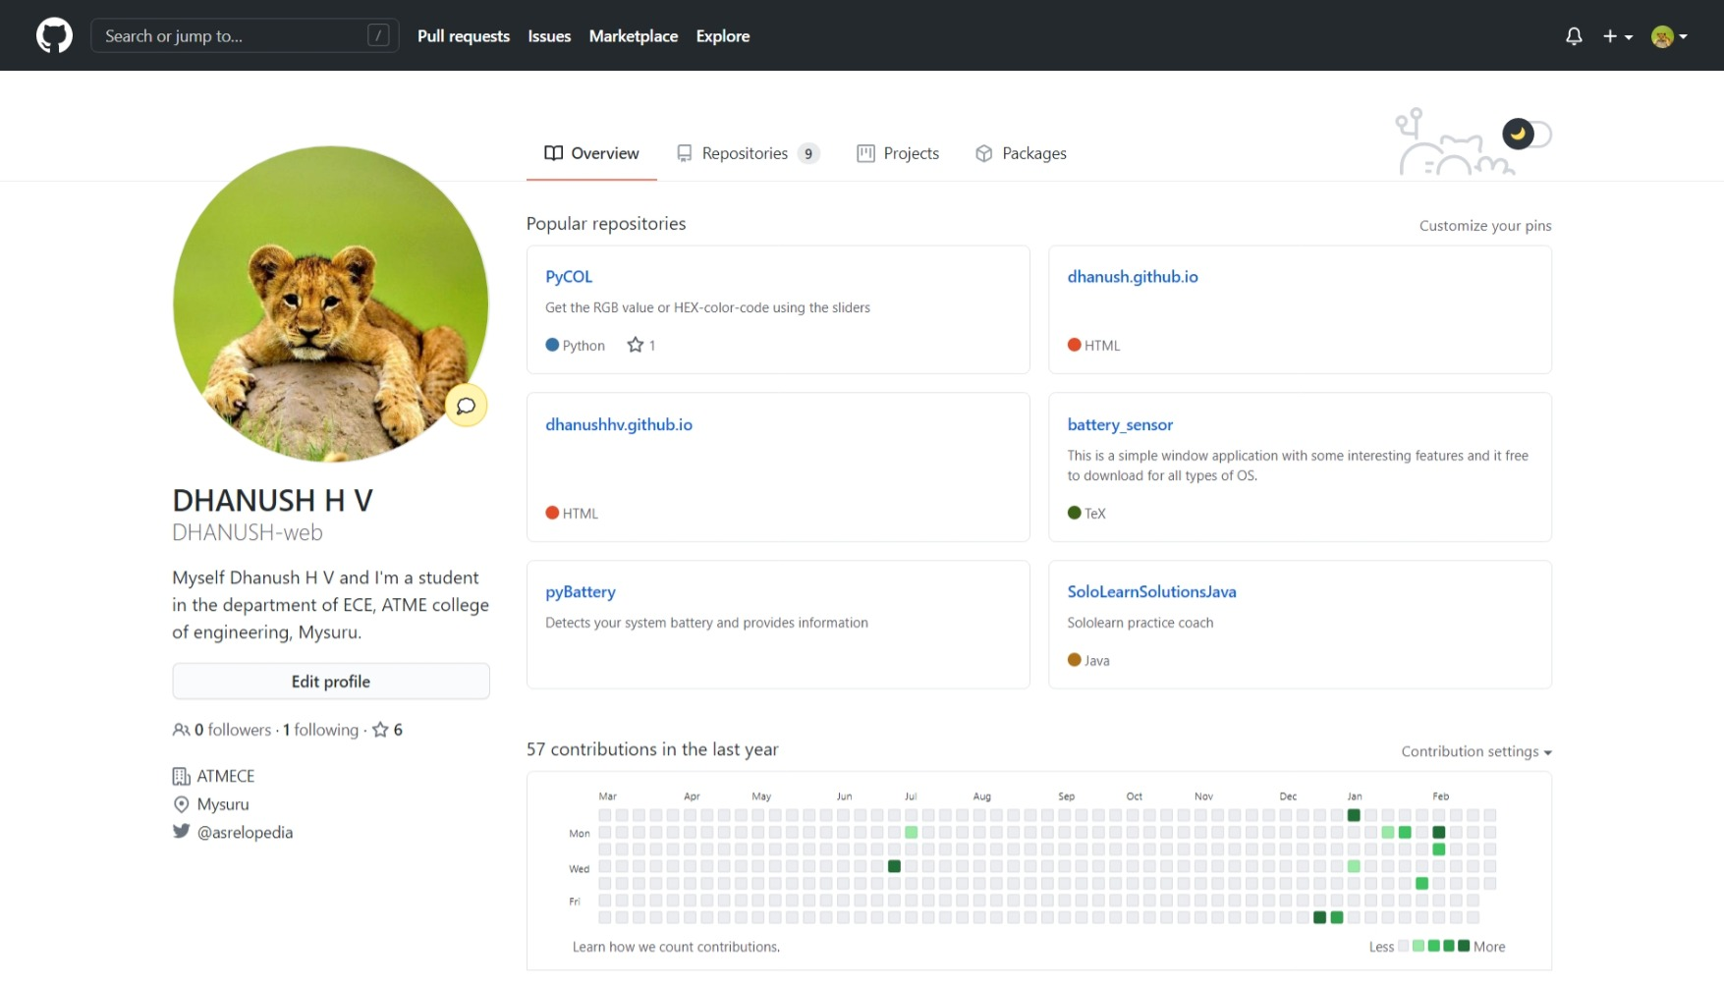
DHANUSH H V Projects

Slide 4
https://www.github.com/DHANUSH-web

